Slide 1
Introduction
Unit - 1
Prepared by Er. Prashant Pant

Slide 2
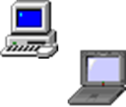
Introduction
Computing systems are everywhere
Most of us think of “desktop” computers
PC’s
Laptops
Mainframes
Servers
But there’s another type of computing system
Far more common...

Slide 3
Definition
Embedded computing systems
Computing systems embedded within electronic devices
Hard to define. Nearly any computing system other than a desktop computer
Billions of units produced yearly, versus millions of desktop units
Perhaps 50 per household and per automobile

Slide 4
Definition
Billions of computing systems are built every year for a very different purpose: they are embedded within larger electronic devices, repeatedly carrying out a particular function, often going completely unrecognized by the device’s user.
An embedded system is nearly any computing system other than a desktop, laptop, or mainframe computer.
One might say that nearly any device that runs on electricity either already has, or will soon have, a computing system embedded within it

Slide 5
Common Electronic Devices
Embedded systems are found in a variety of common electronic devices, such as:
consumer electronics -- cell phones, pagers, digital cameras, camcorders, videocassette recorders, portable video games, calculators, and personal digital assistants;
home appliances -- microwave ovens, answering machines, thermostat, home security, washing machines, and lighting systems;
office automation -- fax machines, copiers, printers, and scanners;
business equipment -- cash registers, curbside check-in, alarm systems, card readers, product scanners, and automated teller machines;
automobiles -- transmission control, cruise control, fuel injection, anti-lock brakes, and active suspension

Slide 6
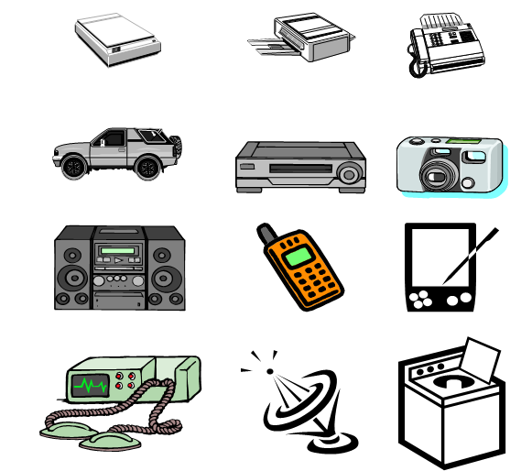
List of Some More Devices
Anti-lock brakes
Auto-focus cameras
Automatic teller machines
Automatic toll systems
Automatic transmission
Avionic systems
Battery chargers
Camcorders
Cell phones
Cell-phone base stations
Cordless phones
Cruise control
Curbside check-in systems
Digital cameras
Disk drives
Electronic card readers
Electronic instruments
Electronic toys/games
Factory control
Fax machines
Fingerprint identifiers
Home security systems
Life-support systems
Medical testing systems
Modems
MPEG decoders
Network cards
Network switches/routers
On-board navigation
Pagers
Photocopiers
Point-of-sale systems
Portable video games
Printers
Satellite phones
Scanners
Smart ovens/dishwashers
Speech recognizers
Stereo systems
Teleconferencing systems
Televisions
Temperature controllers
Theft tracking systems
TV set-top boxes
VCR’s, DVD players
Video game consoles
Video phones
Washers and dryers

Slide 7
Common Characteristics
Single-functioned: An embedded system usually executes only one program, repeatedly. For example, a pager is always a pager.
Example: Washing Machine, Digital Camera, Microwave Oven, thermostat, etc.
In contrast, a desktop system executes a variety of programs, like spreadsheets, word processors, and video games, with new programs added frequently.

Slide 8
Common Characteristics
Tightly constrained: All computing systems have constraints on design metrics, but those on embedded systems can be especially tight.
A design metric is a measure of an implementation features, such as cost, size, performance, and power. (More on this later)
Embedded systems often must cost just a few dollars, must be sized to fit on a single chip, must perform fast enough to process data in real-time, and must consume minimum power to extend battery life or prevent the necessity of a cooling fan.

Slide 9
Common Characteristics
Reactive and real-time: Many embedded systems must continually react to changes in the system’s environment, and must compute certain results in real time without delay.
For example, a car's cruise controller continually monitors and reacts to speed and brake sensors. It must compute acceleration or decelerations amounts repeatedly within a limited time; a delayed computation result could result in a failure to maintain control of the car.
In contrast, a desktop system typically focuses on computations, with relatively infrequent (from the computer’s perspective) reactions to input devices.

Slide 10
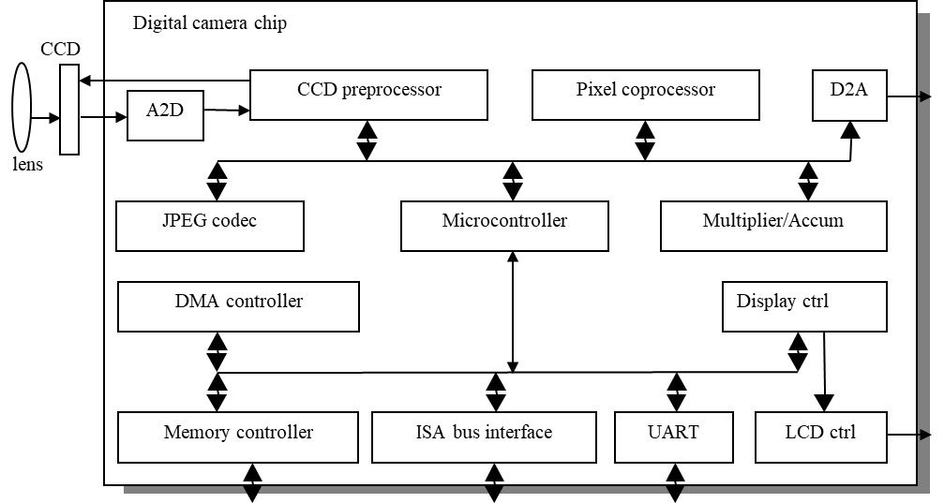
Example: Camera
Single-functioned
always a digital camera
Tightly-constrained
Low cost, low power, small, fast
Reactive and real-time
only to a small extent

Slide 11
Embedded Vs General Purpose System
Refer to the Characteristics and contrast them with General Purpose System.
Difference Between General Computer and Embedded System (Tutorialspoint)
Parameter | Computer | Embedded System
Basic | A computer is a general purpose electronic device used to perform different types of tasks. | An embedded system is a specialized computer system that used to perform one or a few specific tasks.
Purpose | Computers are used for accomplishing general purpose computing tasks. | Embedded systems are used for accomplishing specific tasks in a larger system.

Slide 12
Embedded Vs General Purpose System
Parameter | General Purpose | Embedded System
System hardware | A computer typically consists of a CPU, storage unit, and I/O units. | Embedded system are designed with a microcontroller which consists of a CPU, memory unit, and I/O interface on a single IC chip.
Processing power | Computers have very high processing power. | Embedded systems have relatively low processing power.
Storage capacity | Computers have high storage capacity or memory to store data and information on the system. | Embedded systems have less memory capacity as compared to computers.

Slide 13
Application and Domain - Health Care
Embedded systems expertise is crucial in the development of diagnostic medical devices, impacting four key areas:
Real-Time Processing and Accuracy: Embedded systems enable rapid and accurate analysis of medical data, essential for timely diagnostics and patient outcomes.
Reliability and Safety Compliance: Experts ensure devices meet stringent safety standards and regulatory requirements, contributing to their reliability and accuracy.
Power Efficiency and Battery Management: Optimizing power consumption and extending battery life are vital for portable diagnostic devices, ensuring they function effectively in various clinical settings.
Interoperability and Connectivity: Embedded systems facilitate seamless integration with other healthcare systems, ensuring secure data sharing and supporting telemedicine and integrated healthcare platforms.

Slide 14
Application and Domain - Health Care
Magnetic Resonance Imaging (MRI) Machines: These use embedded systems to process and display detailed images of the inside of the body.
Computed Tomography (CT) Scanners: Embedded systems help in capturing and processing cross-sectional images of the body.
Defibrillators: These devices use embedded systems to monitor heart rhythms and deliver shocks when necessary.
Blood Pressure Monitors: Embedded systems enable these devices to measure and display blood pressure readings accurately.
Digital Flow Sensors: Used in various medical applications to measure the flow of gases or liquids.
Fetal Heart Monitors: These devices use embedded systems to monitor the heart rate of a fetus during pregnancy.
Wearable Devices: Such as fitness trackers and smartwatches, which monitor various health metrics like heart rate, steps, and sleep patterns

Slide 15
Application and Domain - IOT
Smart Home Devices:
Smart Thermostats: Devices like the Nest Thermostat use embedded systems to control home heating and cooling based on user preferences and environmental data.
Smart Locks: These allow remote locking and unlocking of doors, enhancing home security through embedded systems and IoT connectivity.
Wearable Health Monitors:
Fitness Trackers: Devices like Fitbit monitor physical activity, heart rate, and sleep patterns, sending data to smartphones for analysis.
Smartwatches: Apple Watch and similar devices track health metrics and provide notifications, integrating seamlessly with other IoT devices.

Slide 16
Application and Domain - IOT
Industrial IoT (IIoT):
Predictive Maintenance Systems: Embedded systems in machinery monitor performance and predict failures, reducing downtime and maintenance costs.
Smart Sensors: Used in manufacturing to monitor conditions like temperature, humidity, and pressure, ensuring optimal operation.
Agricultural IoT:
Smart Irrigation Systems: These use soil moisture sensors and weather data to optimize watering schedules, conserving water and improving crop yields.
Livestock Monitoring: Embedded systems track the health and location of livestock, providing real-time data to farmers.

Slide 17
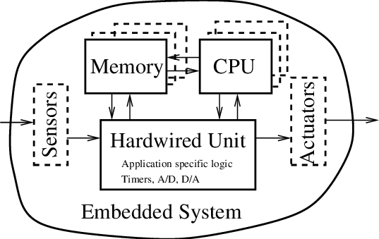
Key Components

Slide 18
Key Components - Microcontroller
A microcontroller is a small computer on a single integrated circuit
A microcontroller contains one or more CPUs (processor cores) along with memory and programmable input/output peripherals.
A self-contained system with a processor, memory and peripherals and can be used as an embedded system
Program memory in the form of NOR flash, OTP ROM, or ferroelectric RAM is also often included on the chip, as well as a small amount of RAM.
Microcontrollers are designed for embedded applications, in contrast to the microprocessors used in personal computers or other general-purpose applications consisting of various discrete chips.
Source: Wikipedia

Slide 19
Microcontroller
Usage: Microcontrollers are used in automobile engine control systems, implantable medical devices, remote controls, office machines, appliances, power tools, toys, and other embedded systems.
I/O Devices: Typical input and output devices include switches, relays, solenoids, LED's, small or custom liquid-crystal displays, radio frequency devices, and sensors for data such as temperature, humidity, light level etc.
Interrupt Handling: Microcontrollers must provide real-time response to events in the embedded system they are controlling.
Source: Wikipedia

Slide 20
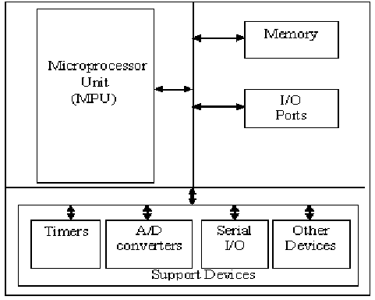
Microcontroller (Diagram)
Describe the Components (Refer to any of the Textbook)

Slide 21
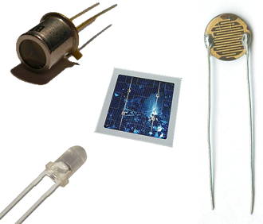
Key Component - Sensor
Definition: In the broadest definition, a sensor is a device, module, machine, or subsystem that detects events or changes in its environment and sends the information to other electronics, frequently a computer processor.
Usage: Sensors are used in everyday objects such as automatic Doors (Piezoelectric Sensors) and fans which operate by placing hand near the base.
A good sensor obeys the following rules:
It is sensitive to the measured property
It is insensitive to any other property likely to be encountered in its application, and
It does not influence the measured property.

Slide 22
Key Component - Sensor
Key Terms
Sensitivity: A sensor's sensitivity indicates how much its output changes when the input quantity it measures changes. For instance, if the mercury in a thermometer moves 1 cm when the temperature changes by 1 °C, its sensitivity is 1 cm/°C
Resolution: The sensor resolution or measurement resolution is the smallest change that can be detected in the quantity that is being measured. The resolution of a sensor with a digital output is usually the numerical resolution of the digital output

Slide 23
Key Component - Actuators
An actuator is a component of a machine that produces force, torque, or displacement, usually in a controlled way, when an electrical, pneumatic or hydraulic input is supplied to it in a system (called an actuating system).
An actuator converts such an input signal into the required form of mechanical energy.
It is a type of transducer.
In simple terms, it is a "mover".

Slide 24
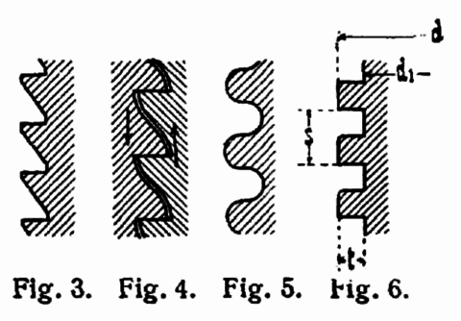
Key Component - Actuators
The displacement achieved is commonly linear or rotational, as exemplified by linear motors and rotary motors, respectively.
Rotary motion is more natural for small machines making large displacements.
By means of a leadscrew, rotary motion can be adapted to function as a linear actuator (a linear motion, but not a linear motor).

Slide 25
Key Component - Actuators
Another broad classification of actuators separates them into two types: incremental-drive actuators and continuous-drive actuators.
Stepper motors are one type of incremental-drive actuators.
Examples of continuous-drive actuators include DC torque motors, induction motors, hydraulic and pneumatic motors, and piston-cylinder drives (rams).

Slide 26
Key Component - Peripheral
A peripheral device, or simply peripheral, is an auxiliary hardware device that a computer uses to transfer information externally. A peripheral is a hardware component that is accessible to and controlled by a computer but is not a core component of the computer.
A peripheral can be categorized based on the direction in which information flows relative to the computer:
The computer receives data from an input device; examples: mouse, keyboard, scanner, game controller, microphone and webcam
The computer sends data to an output device; examples: monitor, printer, headphones, and speakers
The computer sends and receives data via an input/output device; examples: storage device (such as disk drive, solid-state drive, USB flash drive, memory card and tape drive), modem, router, gateway and network adapter

Slide 27
Reference
F. Vahid and T. Givargis, Embedded System Design: A Unified Hardware/Software Introduction. John Wiley & Sons, 2002.
"Actuator," Wikipedia, The Free Encyclopedia, 25 Sep. 2024. [Online]. Available: https://en.wikipedia.org/wiki/Actuator. [Accessed: Sep. 25, 2024].
"Microcontroller," Wikipedia, The Free Encyclopedia, 25 Sep. 2024. [Online]. Available: https://en.wikipedia.org/wiki/Microcontroller. [Accessed: Sep. 25, 2024].
"Sensor," Wikipedia, The Free Encyclopedia, 25 Sep. 2024. [Online]. Available: https://en.wikipedia.org/wiki/Microcontroller. [Accessed: Sep. 25, 2024].
"Peripherals," Wikipedia, The Free Encyclopedia, 25 Sep. 2024. [Online]. Available: https://en.wikipedia.org/wiki/Microcontroller. [Accessed: Sep. 25, 2024].

